Slide 1

COLLECTION IN JAVA

Slide 2
CONTENTS
1. An Overview of the Java Collections Framework
2. Lists
3. Sets
4. Queues
5. Maps

Slide 3
1.1 Java Collection Framework
Java Collections can achieve all the operations that you perform on a data such as searching, sorting, insertion, manipulation, and deletion
The Collection in Java is a framework that provides an architecture to store and manipulate the group of objects
A Collection groups together elements and allows them to be accessed and retrieved later
Note: “Collection” and “Collections” is different!

Slide 4
1.1 Java Collection Framework
Each collection class implements an interface from a hierarchy
Each class is designed for a specific type of storage
java.util package contains all class and interface of Collection

Slide 5
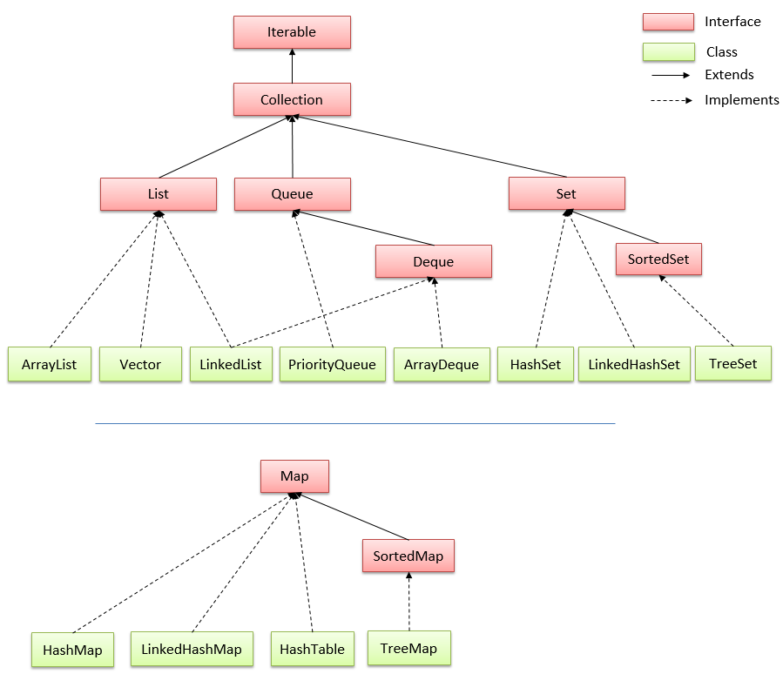
1.2 Hierarchy Of Collection Framework

Slide 6
1.3 Lists
A list is a collection that maintains the order of its elements
It can have the duplicate elements
ArrayList:
● Stores a list of items in a dynamically sized array
LinkedList:
● Allows speedy insertion and removal of items from the list

Slide 7
1.3 Sets
A set is unordered collection of unique elements
Cannot hold duplicate elements.
HashSet:
● Uses hash tables to speed up finding, adding, and removing elements
TreeSet:
● Uses a binary tree to speed up finding, adding, and removing elements

Slide 8
1.4 Stack and Queues
Another way of gaining efficiency in a collection is to reduce the number of operations available
Stack:
● Remember the order of its elements, but it does not allow you to insert elements in every position
● You can only add and remove elements at the top
Queues:
● Add items to one end (the tail)
● Remove them from the other end (the head)
● Example: Aline of people waiting for a bank teller

Slide 9
1.5 Maps
A map stores keys, values, and the associations between them
HashMap:
● Keys can get null value but cant duplicate, if not it happend override
● No order
TreeMap:
● Must not null
● In ascending order

Slide 10
1.6 The Collection Interface
List , Queue and Set are specialized interfaces that inherit from the Collection interface
All share the following commonly used methods
No | Method | Description
1 | public boolean add(E e) | It is used to insert an element in this collection.
2 | public boolean addAll(Collection<? extends E> c) | It is used to insert the specified collection elements in the invoking collection.
3 | public boolean remove(Object element) | It is used to delete an element from the collection.
4 | Public boolean removeAll(Collection<?> c) | It is used to delete all the elements of the specified collection from the invoking collection.
5 | default boolean removeIf(Predicate<? super E> filter) | It is used to delete all the elements of the collection that satisfy the specified predicate.

Slide 11
1.6 The Collection Interface
No | Method | Description
6 | public boolean retainAll(Collection<?> c) | It is used to delete all the elements of invoking collection except the specified collection.
7 | public int size() | It returns the total number of elements in the collection.
8 | public void clear() | It removes the total number of elements from the collection.
9 | public boolean contains(Object element) | It is used to search an element.
11 | public Iterator iterator() | It returns an iterator.
12 | public Object[] toArray() | It converts collection into array.
13 | public <T> T[] toArray(T[] a) | It converts collection into array. Here, the runtime type of the returned array is that of the specified array.
14 | public boolean isEmpty() | It checks if collection is empty.
15 | default Stream<E> parallelStream() | It returns a possibly parallel Stream with the collection as its source.

Slide 12
1.6 The Collection Interface
No | Method | Description
16 | default Stream<E> stream() | It returns a sequential Stream with the collection as its source.
17 | default Spliterator<E> spliterator() | It generates a Spliterator over the specified elements in the collection.
18 | public boolean equals(Object element) | It matches two collections.
19 | public int hashCode() | It returns the hash code number of collection

Slide 13
2.1 ArrayList and Vector
Extends AbstractList and implements the List interface
Supports dynamic arrays that can grows as needed
Created with an initial size
When this size is exceeded, the collection is automatically enlarged
When objects are removed, the array may be shrunk

Slide 14
2.1.1 ArrayList Constructors
The ArrayList class supports three constructors:
● ArrayList(): creates an empty array list with an initial capacity sufficient to hold 10 elements
● ArrayList(int capacity): creates an array list that has the specified initial capacity
● ArrayList(Collection c): creates an array list that is initialized with the elements of collection c

Slide 15
2.1.2 Methods
boolean add(Object o): Appends the specified elements to the end of this list
void add(int index, Object element):
● Inserts the specified element at the specified position index in this list
● Throws IndexOutOfBoundsExcption if the specified index is out of range
Boolean addAll(Collection c):
● Appends all of the elements in the specified collection to the end of this list.
● Throws NullPointerException if the specified collection is null

Slide 16
2.1.2 Methods
void clear(): Removes all of the elements from this list.
object remove(int index): Removes the element at the specified position in this list.
boolean remove(Object o): Remove the first specified object present in the arraylist
int size(): Returns the number of elements in the list
Boolean contains(Object o): Returns true if this list contains the specified element.
Object get(int index): Returns the element at the specified position in this list.
Int indexOf(Object o): Returns the index in this list of the first occurrence of the specified element, or -1 if the List does not contain the element.

Slide 17
2.1.2 Methods
int lastIndexOf(Object o): Returns the index in this list of the last occurrence of the specified element, or -1.
void ensureCapacity (int minCapacity): Increases the capacity of this ArrayList instance, if necessary, to ensure that it can hold at least the number of elements specified by the minimum capacity argument.
Object set(int index, Object element):
● Replaces the element at the specified position in this list with the specified element.
● Throws IndexOutOfBoundsException if the specified index is out of range (index < 0 || index >= size()).

Slide 18
2.1.2 Methods
boolean isEmpty(): used to check whether the Arraylist is empty or not?
Void trimToSize(): reduces the size of an arraylist to the number of elements present in the arraylist.

Slide 19
2.1.3 ArrayList vs Vector
No | Key | ArrayList | Vector
1 | Synchronization | ArrayList is non-synchronized | Vector is synchronized.
2 | Size | ArrayList increments 50% of its current size if element added exceeds its capacity. | Vector increments 100% of its current size if element added exceeds its capacity.
3 | Legacy | ArrayList is not legacy. | Vector is a legacy class.
4 | Speed | ArrayList is faster being non-syncronized. | LinkedList is slower being syncronized.
5 | Iteration | ArrayList uses iterator interface to traverse through elements. | Vector can use both iterator or enumerator interface to traverse through elements.
When there is a certain need for thread-safe, operation Vector needs to be used

Slide 20
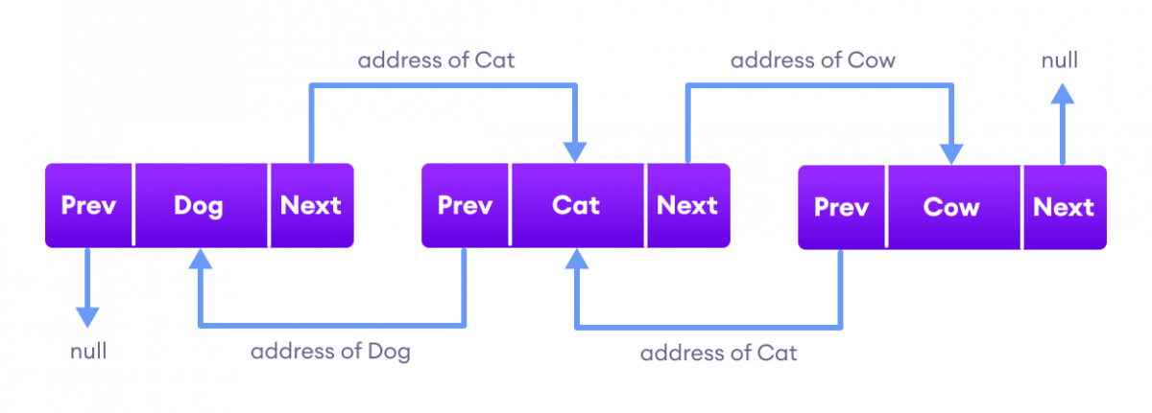
2.2 LinkedList
Linked lists use references to maintain an ordered lists of nodes
Supports dynamic arrays that can grows as needed
The‘head’ of the list references the first node
Each node has a value and a reference to the next node
They can be used to implement
● A List interface
● A Queue interface

Slide 21
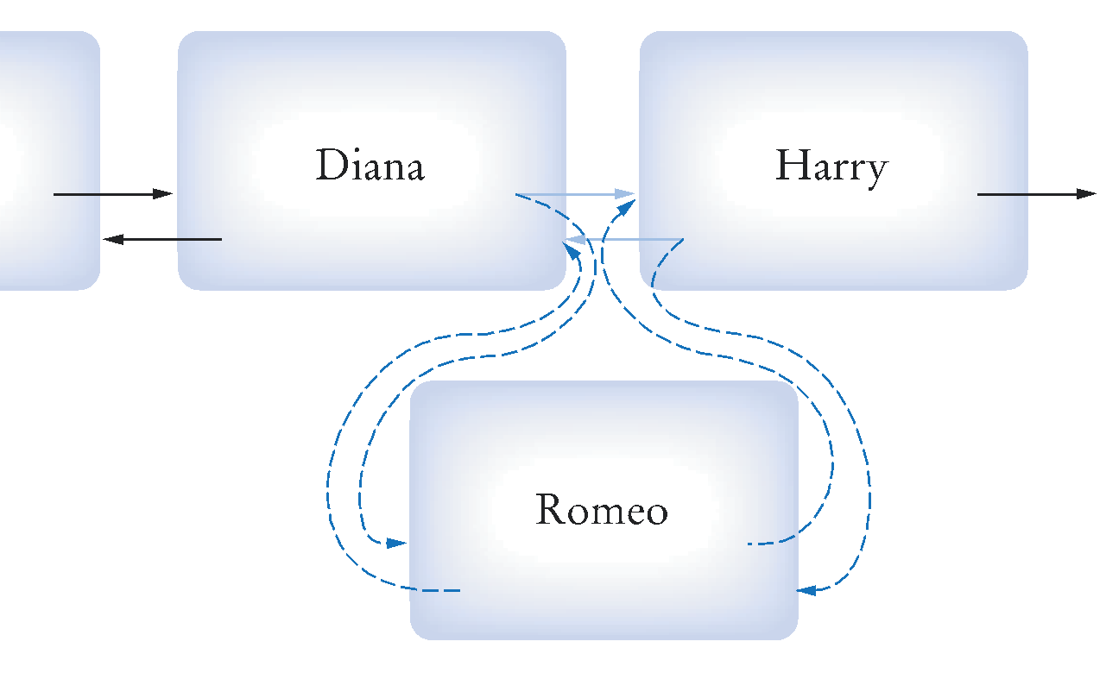
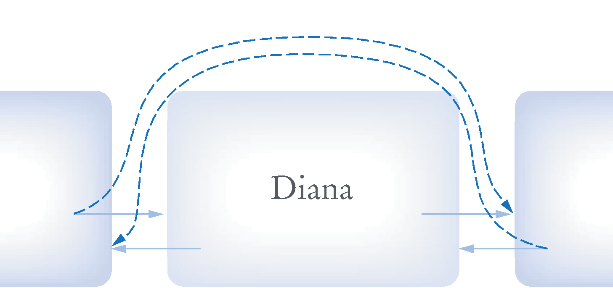
2.2.1 LinkedList Operations
Efficient operations
● Insertion of a node
+ Find the elements it goes between
+ Remap the references
● Removal of a node
+ Find the element to remove
+ Remap neighbor’s references
● Visiting all elements in order
Inefficient operations
● Random access

Slide 22
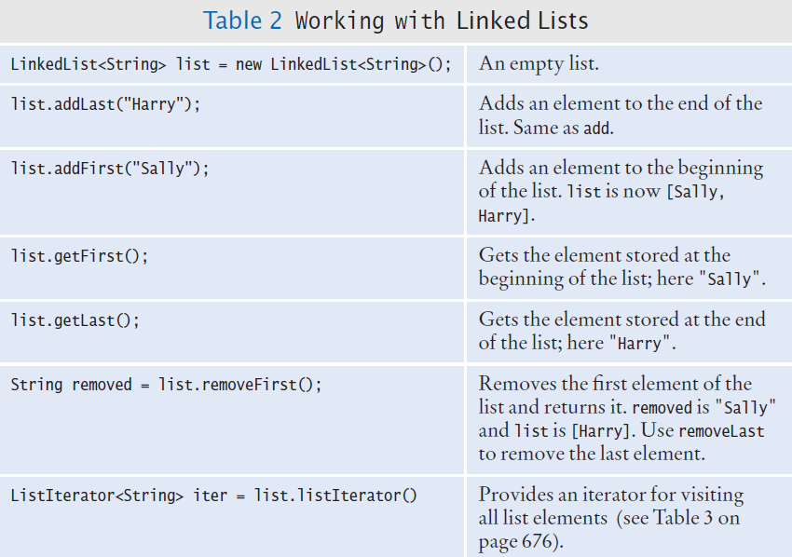
2.2.2 Important Methods

Slide 23
2.2.3 Generic LinkedLists
The Collection Framework uses Generics
Each list is declared with a type field < > angle brackets
LinkedList<String> employeeNames = . . .;
LinkedList<String>
LinkedList<Employee>

Slide 24
2.2.4 LinkedLists as Queue and Deque
Since the LinkedList class also implements the Queue and Deque interface, it can implement methods of these interfaces as well

Slide 25
2.2.4 LinkedLists Vs ArrayList
LinkedList | ArrayList
Implements List, Queue and Deque interfaces | Implements List interface
Stores 3 values (previous address, data, and next address) in a single position. | Stores a single value in a single position.
Provides the doubly-linked list implementation. | Provides a resizable array implementation.
Whenever an element is added, previous and next address are changed. | Whenever an element is added, all elements after that position are shifted.
To access an element, we need to iterate from the beginning to the element. | Can randomly access elements using indexes.
ArrayList is faster in accessing data.
LinkedList is faster in manipulation of data.

Slide 26
3.1 Sets
A set is an unordered collection
It does not support duplicate elements
The collection does not keep track of the order in which elements have been added
Therefore, it can carry out its operations more efficiently than an ordered collection
The HashSet and TreeSet classes both implement the Set interface

Slide 27
3.1 Sets
HashSet: Stores data in a Hash Table
TreeSet: Stores data in a Binary Tree
Both implementations arrange the set elements so that finding, adding and removing elements is efficient

Slide 28
3.1.1 Hash Table Concept
Set elements are grouped into smaller collections of elements that share the same characteristic
It is usually based on the result of a mathematical calculation on the contents that results in an integer value
In order to be stored in a hash table, elements must have a method to compute their integer values

Slide 29
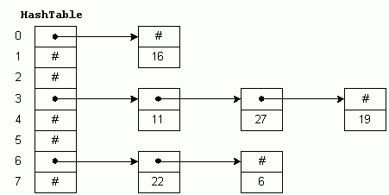
3.1.2 hashCode
The method is called hashCode
If multiple elements have the same hash code (so-called clash), they are stored in a LinkedList

Slide 30
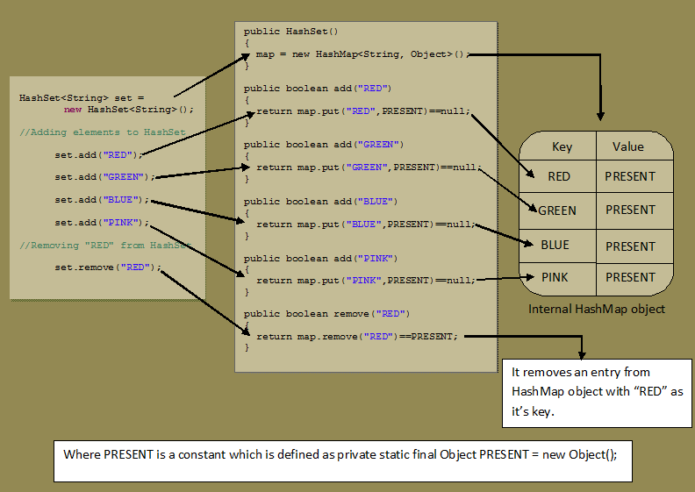
3.1.2 hashCode

Slide 31
3.2.1 LinkedHashSet
The LinkedHashSet class of the Java collections framework provides functionalities of both the hashtable and the linked list data structure
Elements of LinkedHashSet are storded in hash tables similar to HashSet
However, linked hash sets maintain a doubly-linked list internally for all of its elements. The linked list defines the order in which elements are inserted in hash tables

Slide 32
3.2.2 LinkedHashSet vs HashSet
LinkedHashSet maintains a linked list internally. Due to this, it maintains the insertion order of its elements.
The LinkedHashSet class requires more storage than HashSet.
The performance of LinkedHashSet is slower than HashSet

Slide 33
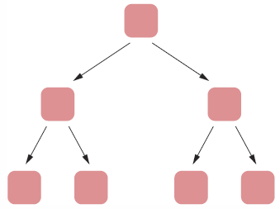
3.3.1 Tree Concept
Set elements are kept in sorted order.
Nodes are not arranged in a linear sequence but in a tree shape.
In order to use a TreeSet, it must be possible to compare the elements and determine which one is “larger”

Slide 34
3.3.2 TreeSet
Use TreeSet for classes that implement the Comparable interface
The nodes are arranged in a ‘tree’ fashion so that each ‘parent’ node has two child nodes.
The node to the left always has a ‘smaller’ value
The node to the right always has a ‘larger’ value

Slide 35
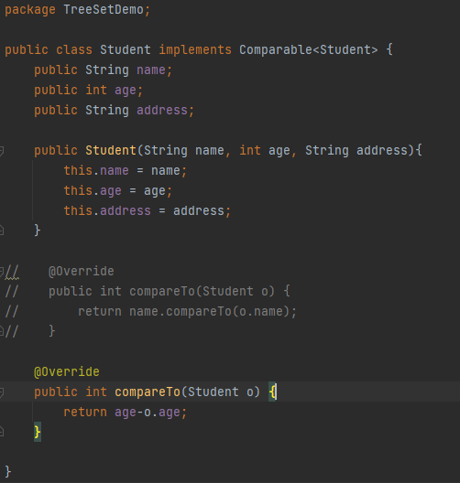
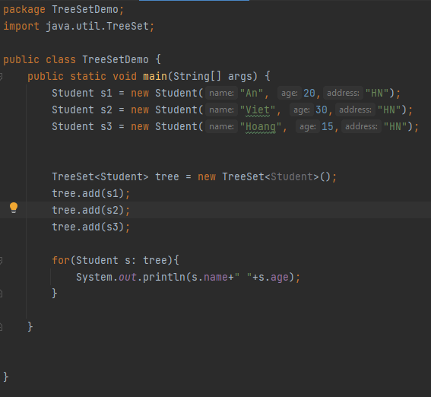

3.3.2 TreeSet

Slide 36
3.4 HashSet – LinkedHashSet - TreeSet
All three doesn’t allow duplicate elementsThe nodes are arranged in a ‘tree’ fashion.
All three are not synchronized
All three are Cloneable and SerializableIterator returned by all three is fail-fast in nature. i.e You will get ConcurrentModificationException if they are modified after the creation of Iterator object
Use cases:
● Use HashSet if you don’t want to maintain any order of elements.
● Use LinkedHashSet if you want to maintain insertion order of elements.
● Use TreeSet if you want to sort the elements according to some Comparator.

Slide 37
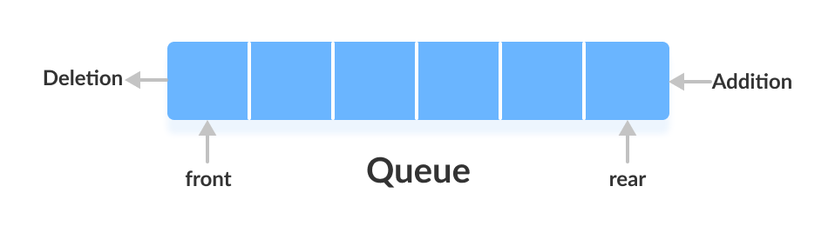
4.1 Queues
The Queue interface of the Java collections framework provides the functionality of the queue data structure. It extends the Collection interface.
In order to use the functionalities of Queue, we need to use classes that implement it:
● ArrayDeque
● LinkedList
● PriorityQueue
In queues, elements are stored and accessed in First In, First Out manner. That is, elements are added from the behind and removed from the front.

Slide 38
4.1.1 ArrayDeque
Provides a way to apply resizable-array in addition to the implementation of the Deque interface
It is also known as Array Double Ended Queue or Array Deck
Few important features of ArrayDeque are as follows:
● Array deques have no capacity restrictions and they grow as necessary to support usage
● They are not thread-safe which means that in the absence of external synchronization, ArrayDeque does not support concurrent access by multiple threads
● Null elements are prohibited in the ArrayDeque.
● ArrayDeque class is likely to be faster than Stack when used as a stack.
● ArrayDeque class is likely to be faster than LinkedList when used as a queue.

Slide 39
4.1.1 ArrayDeque as a Stack
To implement a LIFO (Last-In-First-Out) stacks in Java, it is recommended to use a deque over the Stack class
ArrayDeque provides the following methods that can be used for implementing a stack:
● push(): adds an element to the top of the stack
● peek(): returns an element from the top of the stack
● pop(): returns and removes an element from the top of the stack

Slide 40
4.2.1 PriorityQueue
The PriorityQueue class provides the functionality of the heap data structure
Unlike normal queues, priority queue elements are retrieved in sorted order
In a queue, the first-in-first-out rule is implemented whereas, in a priority queue, the values are removed on the basis of priority. The element with the highest priority is removed first.

Slide 41
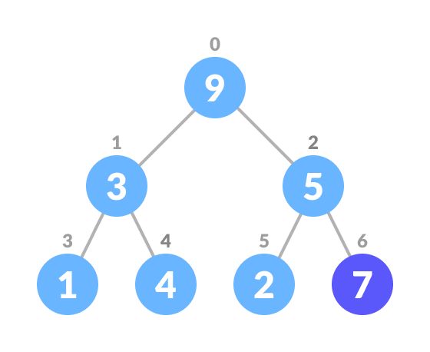
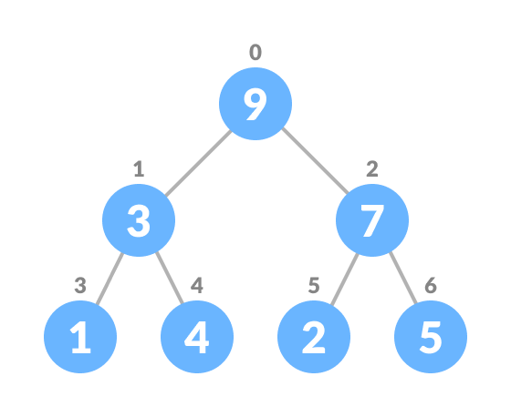
4.2.2 Inserting An Element into the PriorityQueue

Slide 42
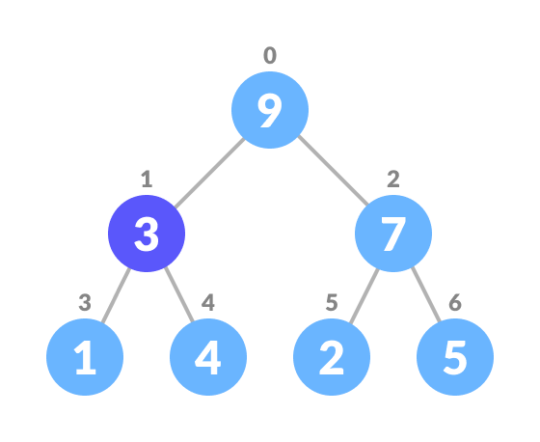
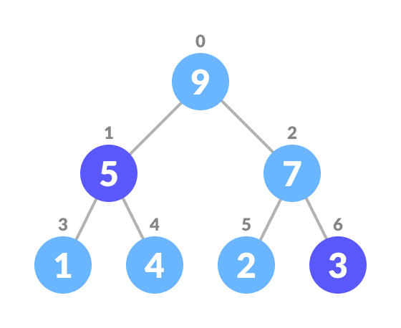
4.2.3 Deleting An Element from the PriorityQueue

Slide 43
4.2.4 Important points on PriorityQueue
The PriorityQueue doesn’t permit null
We can’t create PriorityQueue of Objects that are non-comparable
Since PriorityQueue is not thread-safe, so java provides PriorityBlockingQueue class that implements the BlockingQueue interface to use in java multithreading environment
It provides O(log(n)) time for add and poll methods

Slide 44
5.1 Maps
A map allows you to associate elements from a key set with elements from a value collection
The HashMap and TreeMap classes both implement from the Map interface.
Use a map to look up objects by using a key.

Slide 45
5.1 Maps
A map allows you to associate elements from a key set with elements from a value collection
The HashMap and TreeMap classes both implement the Map interface.
Use a map to look up objects by using a key.

Slide 46
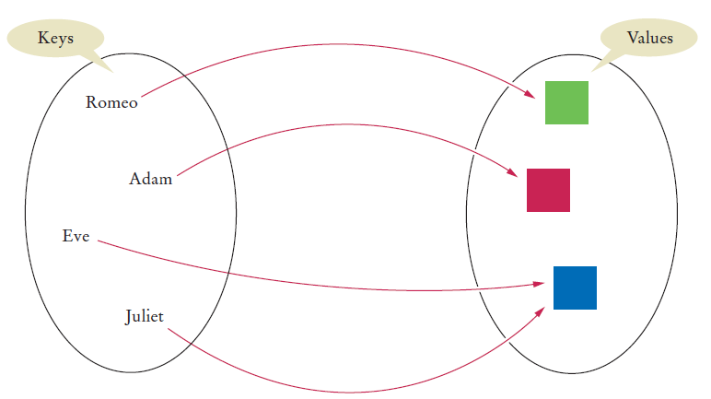
5.1 Maps
The key “unlocks” the “data”(value)
A map is like a mathematical function Mapping between two sets

Slide 47
5.1 HashMaps
The HashMap class of Java collections framework provides the functionality of the hash table data structure
It stores elements in key/value pairs. Here, keys are unique identifiers used to associate each value on a map
The HashMap class implements the Map interface

Slide 48
5.2 TreeMap
Java TreeMap class is a red-black tree based implementation. It provides and efficient means of storing key-value pairs in sorted order.
The important points about TreeMap class are:
Java TreeMap contains values based on the key. It implements the NavigableMap interface and extends AbstractMap class
Contains only unique elements
Cannot have a null key but can have multiple values
TreeMap is non synchronized
TreeMap maintains ascending order

Slide 49
5.2 Treemaps vs HashMap
 | HashMap | TreeMap
Definition | Hashtable based implementation of Map interface | Tree structure based implementation of Map interface
Null Keys/ Values | Allows a single nullkey and multiple null values | Does not allow null keys but can have multiple null values
Performance | Faster because it provides constant-time performance that is O(1) for the basic operations like get() and put() | Slower because it provides the performance of O(log(n)) for most operations like add(), remove() and contains()
Order of elements | does not maintain any order | The elements are sorted in natural order (ascending)
Uses | should be used when we do not require key-value pair in sorted order. | should be used when we require key-value pair in sorted (ascending) order

